Slide 1
IMDB MOVIE ANALYSIS
SANTHOSH S
BATCH - DMT6

Slide 2
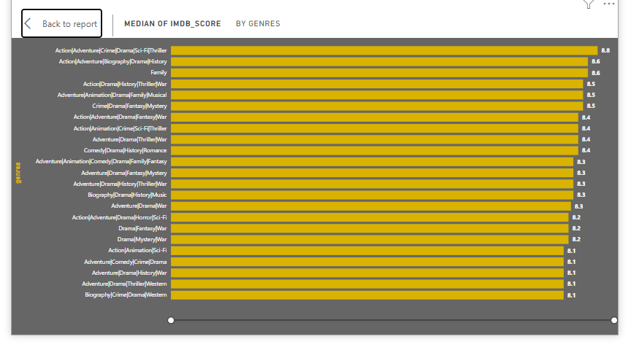
Task: Determine the most common genres of movies in the dataset. Then, for each genre, calculate descriptive statistics (mean, median, mode, range, variance, standard deviation) of the IMDB scores.
The chart highlights that genres like Action/Adventure/Crime/Drama/Sci-Fi/Thriller have the highest median IMDb score of 8.8, while a combination of other genres, including Biography/Crime/Drama/Western, has the lowest among the listed categories, with a score of 8.1. This suggests a small range in the median IMDb ratings across various genre combinations.

Slide 3
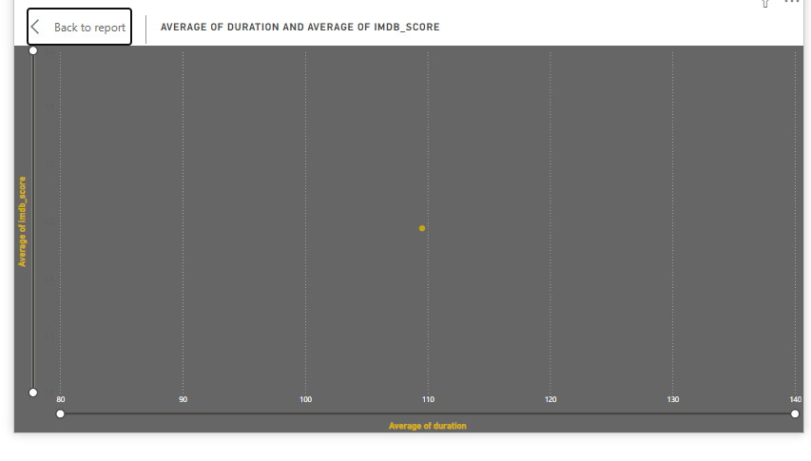
Task: Analyze the distribution of movie durations and identify the relationship between movie duration and IMDB score.
The average duration is 109.55 minutes.
The average IMDB score is 6.44.

Slide 4
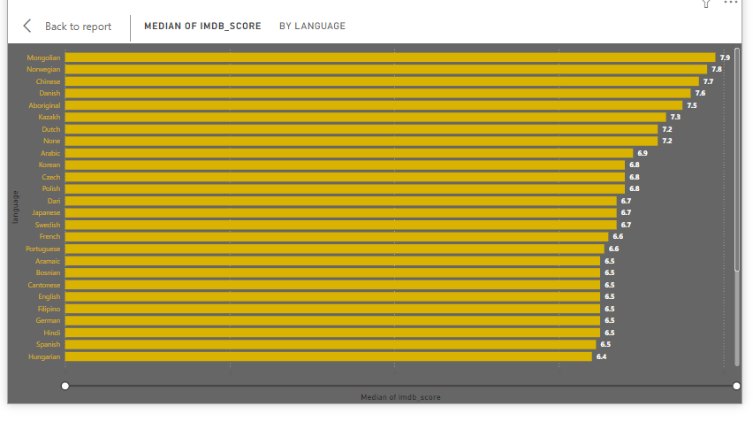
Task: Determine the most common languages used in movies and analyze their impact on the IMDB score using descriptive statistics.
The chart shows median IMDB scores by language. Mongolian films have the highest score at 7.9, followed by Norwegian (7.8) and Chinese (7.7). In contrast, Filipino and Spanish films have lower scores around 6.5.

Slide 5
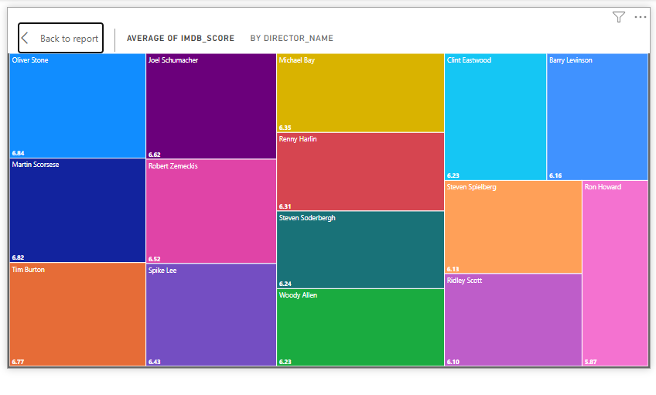
Task: Identify the top directors based on their average IMDB score and analyze their contribution to the success of movies using percentile calculations.
Each box’s size and color indicate different directors, with Oliver Stone having the highest average score (8.64) and Michael Bay the lowest (6.45). This visual allows for quick comparisons of directors based on their films' ratings.

Slide 6
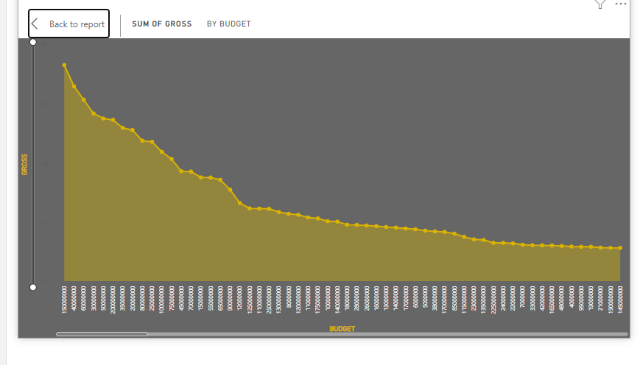
Task: Analyze the correlation between movie budgets and gross earnings, and identify the movies with the highest profit margin.
The chart shows that as the budget increases, gross earnings initially start high but gradually decline. This indicates that higher budgets do not necessarily lead to proportional increases in revenue, suggesting diminishing returns on investment. Overall, it highlights a trend where increased spending results in less significant gains in gross earnings.

Slide 7
